Slide 1
Quick Guide
NEXCORE UML Modeler
(Apache License Version)
SK Holdings

Slide 2
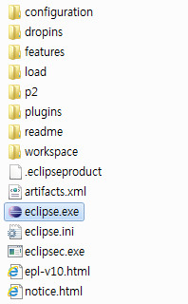
Run UML Modeler
run

Slide 3
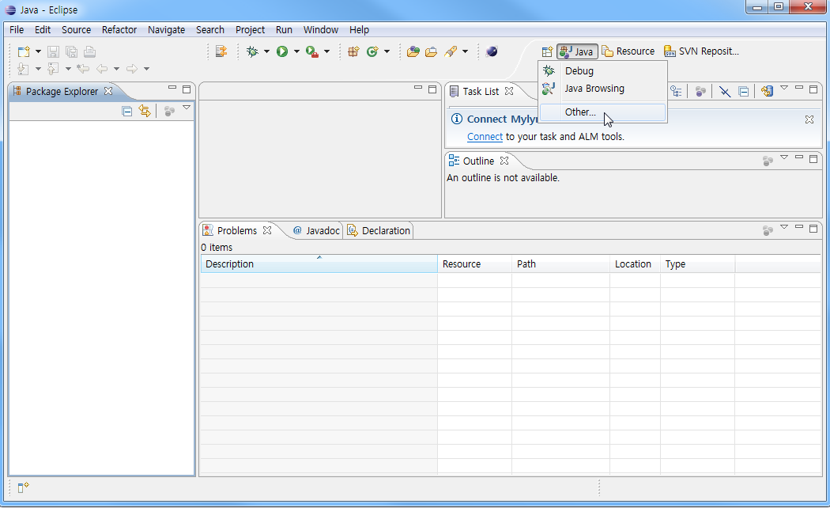
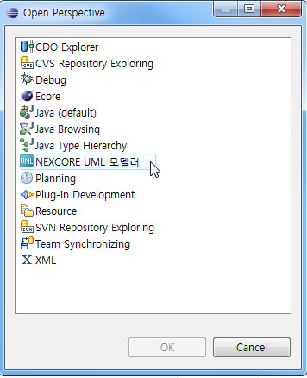
Open Perspective of UML Modeler
1.Open
Perspective
2.Other …
3. Select
UML Modeler

Slide 4
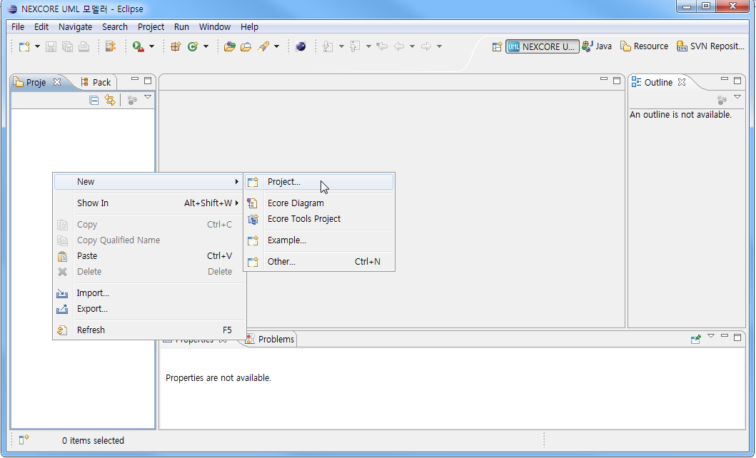
Create UML Project (1/3)
Right-Click

Slide 5
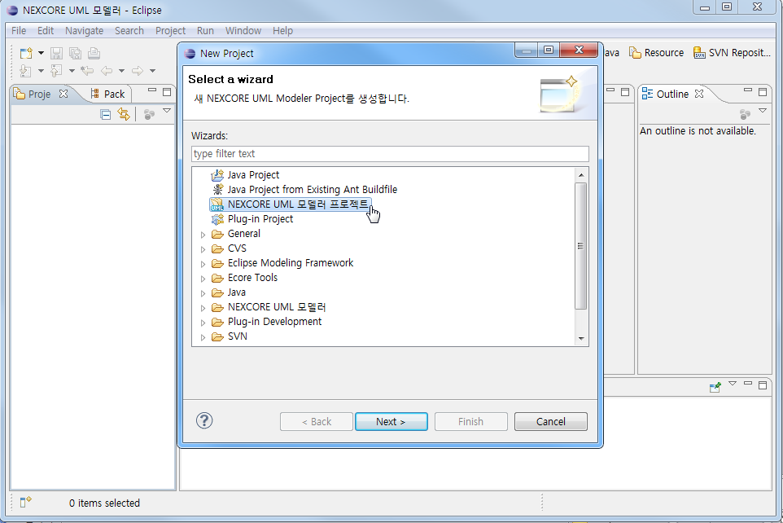
Create UML Project (2/3)

Slide 6
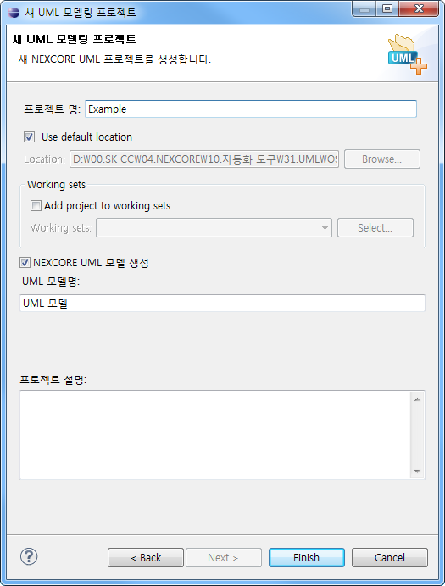
Create UML Project (3/3)
Write
Project Name
Write
Model Name

Slide 7
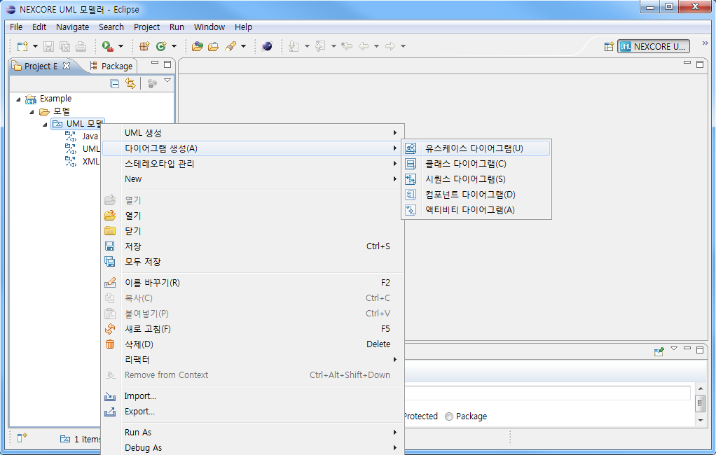
Create UML Diagrams
Right-Click

Slide 8
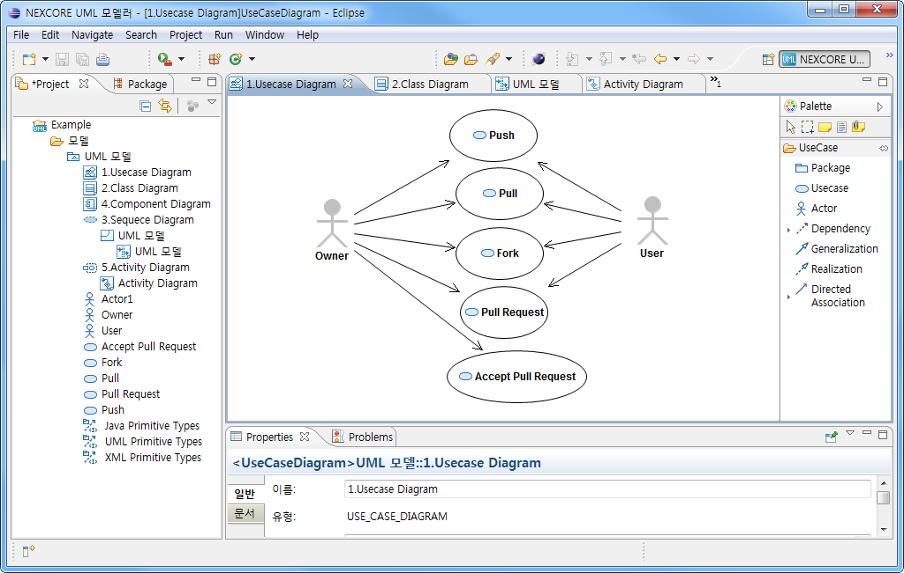
Design UML Diagrams

Slide 9
E.O.D

